Slide 1

Be Worshipful
Ezra
Dr. Rick Griffith • Crossroads International Church Singapore
CICFamily.com • BibleStudyDownloads.org

Slide 2

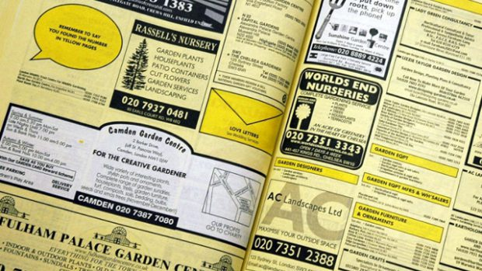
Yellow Pages
How to find a church…
Notes:
When my family moved to Singapore in 1991 for me to teach at Singapore Bible College, after securing our housing, our first item of business was to find a church.
So I did what many people did back then—"let your fingers do the walking" was the slogan of the Yellow Pages.
For those of us who have no idea what I'm talking about—and that is a lot of us since everyone in this church is younger than me—the Yellow Pages was the "go to" place before the internet.
Every organization had their phone number there back in the late 20th century.
• So I looked under "Churches." But I found no entries!
"Really?" I thought. "Surely the churches are in here. There are hundreds of churches in Singapore!"
So I looked up "Christian," but there was no entry there either. Then I tried "Baptist"—no go.
You are laughing, but where would you look?!
Finally, somehow, I found them under "P" alphabetically. Sure enough, the churches were all listed there in the "P" section, under "Places…of Worship"!
At that spot were listed, by religion, the Buddhist, Hindu, Muslim and Christian places of worship.
I guess what hit me most as I saw this was that these were all deemed places of worship—not places of teaching, not places of ministry, not places of gathering, not places evangelizing.
There, right there through my Yellow Pages, God spoke to me. What each religion is doing, more than anything else, is worshipping!

Slide 3

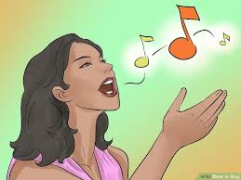
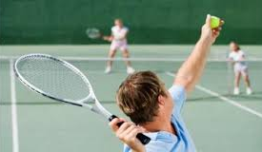
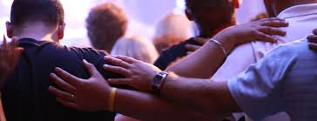
Why church?
Learn?
Sing?
Fellowship?
Notes:
Why do we leave the world to gather in community? Why church?
• Is it to learn and teach?
• Do we gather mostly to sing?
• Is fellowship our chief reason to come together?
• Is our chief reason to gather to serve?
• Oops. That is the wrong kind of serve. I mean do we gather mainly to serve God?
What kind of service is this? It is a WORSHIP service!

Slide 4

Why church?
Learn?
Sing?
Fellowship?
Serve?
Notes:
Why do we leave the world to gather in community? Why church?
• Is it to learn and teach?
• Do we gather mostly to sing?
• Is fellowship our chief reason to come together?
• Is our chief reason to gather to serve?
• Oops. That is the wrong kind of serve. I mean do we gather mainly to serve God?
What kind of service is this? It is a WORSHIP service!

Slide 5
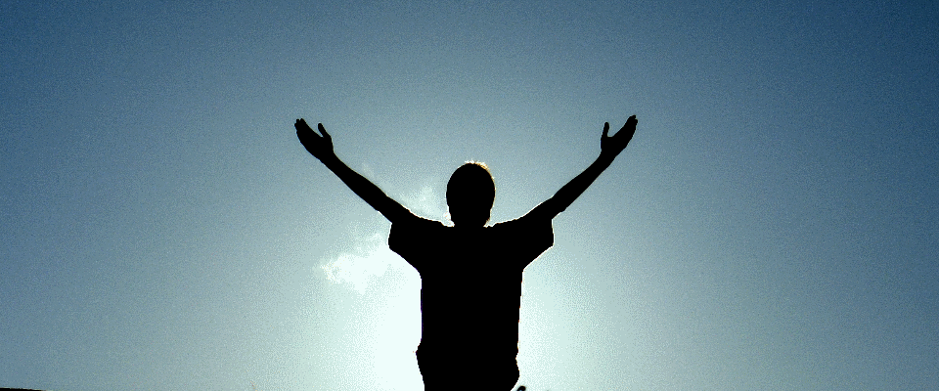
Why does God restore us?
Notes:
Why are we essentially delivered from our old way of life?
God routinely delivers us even though we are at fault for neglecting him. So why does he rescue or deliver us?
There are many answers to this question but today we will look at one that we normally don't think about.

Slide 6
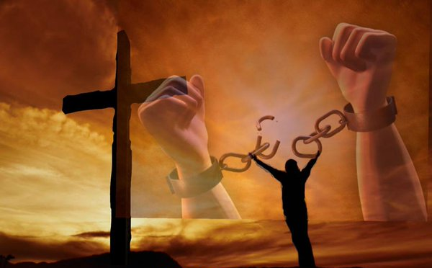
God delivers us from our bondage to worship him.
Main Idea to Apply Ezra
Notes:
The Lord frees us from our slavery for us to give him the honor that we lacked that got us into trouble in the first place.

Slide 7
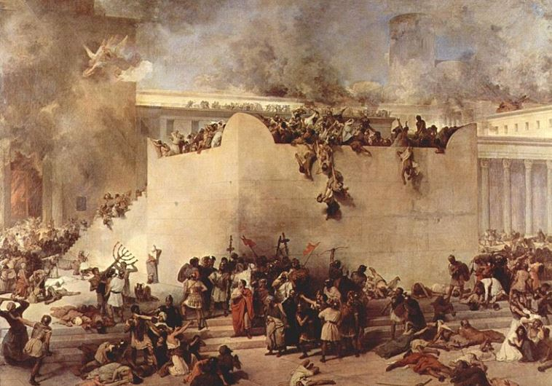
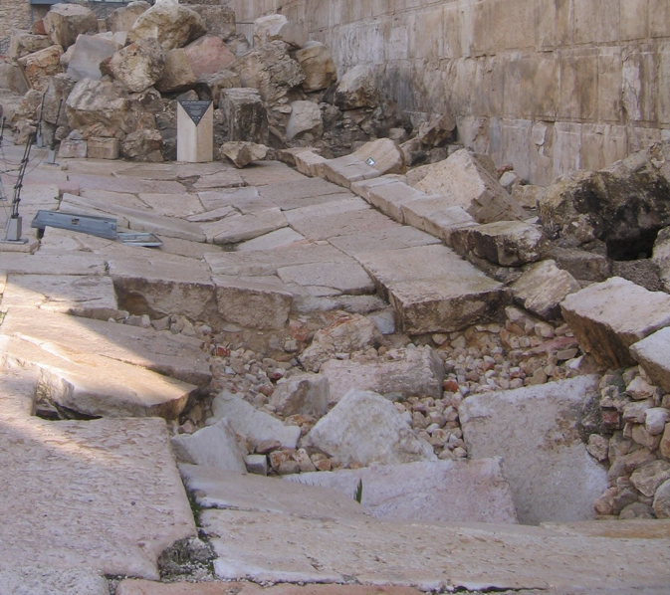
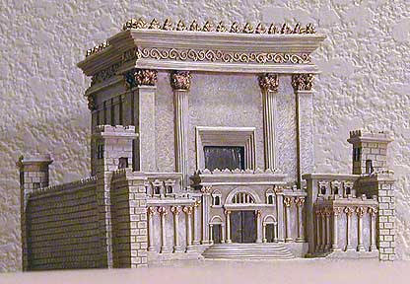
Israel messed up.
The Jews needed restoration.
Only God could restore them.
Notes:
Today we pick up the account in Scripture about 400 years before Jesus. God had disciplined the nation

Slide 8

Two 70-Year Exiles
560
Two 70-Year Exiles
People Exile
605
586
539
536
516
Temple Exile
"This entire land will become a desolate wasteland. Israel and her neighboring lands will serve the king of Babylon for seventy years. ¹²Then, after the seventy years of captivity are over, I will punish the king of Babylon and his people for their sins," says the LORD. I will make the country of the Babylonians a wasteland forever"
(Jer. 25:11-12).

Slide 9


The Postexilic Era
295
296
560
The Postexilic Era
Temple work
Prophets:
Haggai
Zechariah
Malachi
605
586
539
536
520
516
483-473
444-425
Others:
Zerubbabel
Esther
Ezra
Nehemiah
Persian Kings:
Cyrus
Darius
Xerxes
Artaxerxes

Slide 10
JUDAH IS PRESERVED!
Isaiah 9:6-7
DRESSING
THE
STAGE
Summing up…
MS
N(A)
H
SG
C
ER
B
J
MN
DS
E
KB
WHY?
U
MS
Because Messiah was long prophesied to appear through the tribe of Judah.
PG
RS
Handbook pg. 37-38
57
8
Notes:
Summing up this time of ROYALTY…
Remember again that crucial difference when the NORTHERN and the SOUTHERN Kingdoms fell. Recall that
//// the NORTHERN Kingdom, Israel, is attacked by Assyria,
//// taken away into captivity and , through time,
//// absorbed into other societies.
But JUDAH, the SOUTHERN KINGDOM and its people…
//// conquered by Babylon under Nebuchadnezzar…
//// is taken over to Babylon for a TEMPORARY captivity. But Judah is destined to continue to play center stage in the long future history of THE LAND.
//// JUDAH IS PRESERVED and eventually returned to The Land.
////` Why?
//// Because the expected Messiah...long prophesied...was destined by the Old Testament prophets to appear through the tribal line of JUDAH.

Slide 11
2 Kings 25:21
7
CAPTIVITY
The THIRD
of
THREE
SOCIETIES
is:
CAPTIVITY
A R C
Handbook pg. 37-38
58
Notes:
And here is CAPTIVITY's file folder from the Bible File sequence ready for the four items important to this period in the life of ancient Judah.

Slide 12

Daniel 1
The Ancient City of Babylon
CAPTIVITY
Euphrates River
Hanging Gardens of Babylon
Handbook pg. 37-38
59
Notes:
Babylon -- that enormous Oriental metropolis next to the Euphrates River -- is the site of JUDAH's 70 years of captivity, shown here in an artist re-creation of the possible appearance of that incredible city. The famed Hanging Gardens of Babylon -- visible on the right -- were among the Seven Wonders of that Ancient World.

Slide 13
7
CAPTIVITY
BABYLON
PERSIAN GULF
THE STAGE OF THE ACTION
Handbook pg. 37-38
60
Notes:
Remember, also, that Babylon -- located on your map many miles upstream from the Persian Gulf – was very near the heart of today's troubled Persian Gulf region in the Middle East.

Slide 14
Jer. 29:10; Ezra 3:8; Neh. 2:5-6
7
CAPTIVITY
70 YEARS
3 TREKS
A R C
CAPTIVITY
70 Years
3 Treks
"JEWS"
"SYNAGOGUE"
Handbook pg. 37-38
61
3
Notes:
After the 70 years of Judah's exile, the Babylonian rulers allowed the captives from the SOUTHERN KINGDOM OF JUDAH to return to Jerusalem, and to rebuild their city, its walls and their Temple.
//// And it was during this time of the Babylonian Exile that the people of JUDAH came to be called Jews -- from the tribal name of JUDAH.
//// The worldwide Jewish tradition of the synagogue was also born in Babylon during Judah's Captivity or Exile.
//// The Return to The Land took place in 3 massive treks. These were difficult trips on foot from Babylon back to the Land.

Slide 15
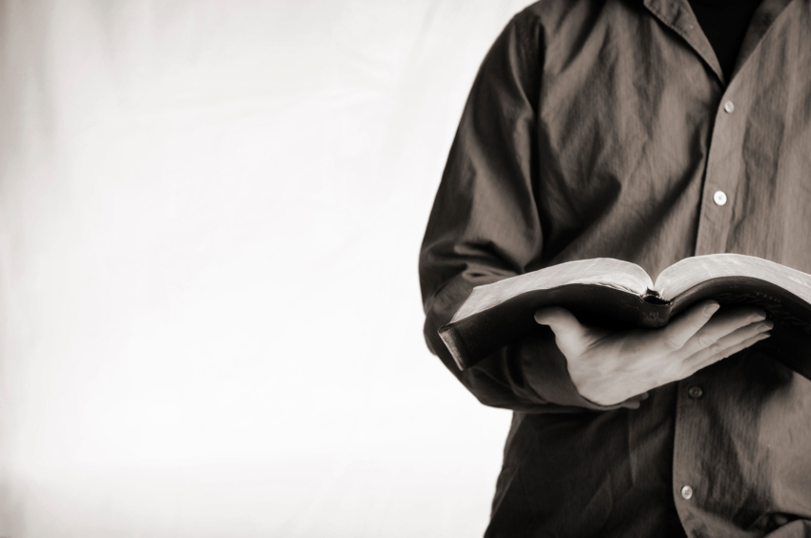
Let's Study Through Scripture
The Bible: Book by Book
Notes:
We are in a study through the whole Bible right now, book by book. The goal is to give us a basic understanding of each book of the Bible.

Slide 16
Why does God restore us?
Why them?
Why us?
Notes:
God routinely delivers us even though we are at fault for neglecting him. So why does he rescue or deliver us?
There are many answers to this question but today we will look at one that we normally don't think about.
• Today we’ll first see why God restored the Jews—
• and then we’ll see why he delivers us.

Slide 17
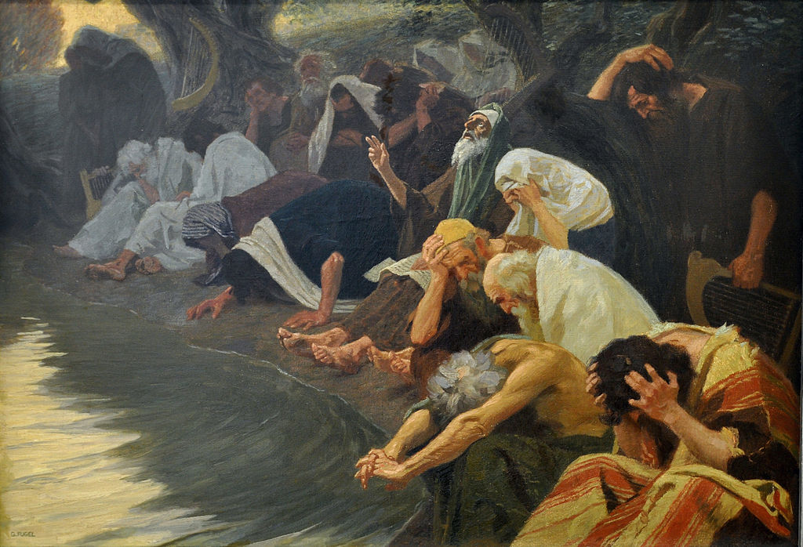
I. God delivered the Jewish exiles to worship him.
The Book of Ezra
Notes:
He brought the Jews from being kicked out of their land back to that land so they would honor him.

Slide 18
Slides on
Ezra 1
Notes:
God used Zerubbabel to return 50,000 exiles to rebuild the temple to worship him (Ezra 1–6; 538 BC).
Cyrus of Persia supported all Jews in Babylon to return to Jerusalem to rebuild the temple as proof of God fulfilling his promise of restoration even through a pagan king (Ezra 1).

Slide 19
7
3 TREKS IN RETURN
A R C
CAPTIVITY
70 Years
3 Treks
THE STAGE OF THE ACTION
Handbook pg. 37-38
62
Notes:
The returning Jews moved up along the Fertile Crescent route probably near the Euphrates River....then finally turning away southward toward the Land of Israel. That route was absolutely necessary. Otherwise the returnees would be unable to survive the harsh desert conditions that lay directly westward between Babylon and Jerusalem.

Slide 20
Ezra 1 through 2
7
CAPTIVITY
70 YEARS
3 TREKS
A R C
100 YEARS / 50,000
CAPTIVITY
70 Years
3 Treks
100 Years / 50,000
Handbook pg. 37-38
63
Notes:
The THREE TREKS back to the land lasted about 100 years. During that time some 50,000 people returned.

Slide 21
Ezra 1:4
50,000 RETURNED!
BUT MANY MORE STAYED BEHIND TO FINANCE THE RETURN.
CAPTIVITY
70 Years
3 Treks
100 Years / 50,000
Handbook pg. 37-38
64
1
Notes:
Even though some 50,000 Jews left Babylon to return to the Land of their Promise…
//// …many Jews back in Babylon had been successful in business, living in their own houses. Those Jews were largely responsible for financing the trips back, and for the work of reconstruction by the returnees.

Slide 22
Jer. 29; Ezra 3; Neh. 2
7
ZERUBBABEL
CAPTIVITY
EZRA
70 YEARS
3 TREKS
A R C
100 YEARS / 50,000
Z - E - N
CAPTIVITY
NEHEMIAH
70 Years
3 Treks
100 Years / 50,000
Z - E - N
Handbook pg. 37-38
65
4
Notes:
During those difficult journeys back to Israel from Babylon, three famous names move into national leadership.
//// Remember those names by recalling the word Z-E-N...these three great men, sometimes called diplomat-priests, in order, were
//// ZERUBBABEL...
//// EZRA... and
//// NEHEMIAH.

Slide 23
Neh. 3
7
ZERUBBABEL…returns to begin rebuilding the Temple.
ZERUBBABEL
CAPTIVITY
EZRA…returns to teach the Law of the Lord.
EZRA
70 YEARS
Z-E-N
3 TREKS
100 YEARS / 50,000
Z - E - N
THREE DIPLOMAT PRIESTS
CAPTIVITY
NEHEMIAH
70 Years
NEHEMIAH…returns as the great Old Testament leader and rebuilder of the city's gates and its walls.
3 Treks
100 Years / 50,000
Z - E - N
Handbook pg. 37-38
66
3
Notes:
ZERUBBABEL is remembered because of his crucial role in beginning the rebuilding of the actual Temple structure, small though it was…
//// EZRA...the great priest who went to Jerusalem to teach the law of the Lord to the returned people...
//// While NEHEMIAH, that famed Old Testament administrator and leader, returned to rebuild the city's gates and walls. In an astonishingly short time, he and his men rebuilt Jerusalem's crucial defenses.
//// These three great men…Z-E-N….Zerubbabel, Ezra and Nehemiah…the diplomat-priests…were at the center of Judah's return, carefully guiding the development of an exiled nation now back in its homeland.

Slide 24
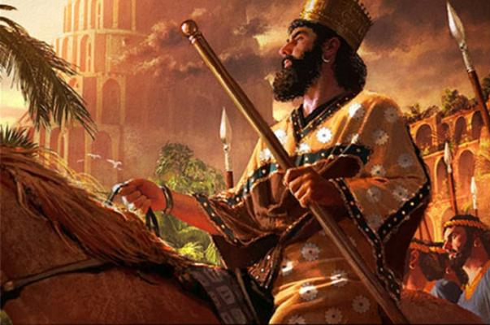
Cyrus the Great Conquers Babylon
"In the first year of King Cyrus of Persia [538 BC], the LORD fulfilled the prophecy he had given through Jeremiah [25:11-12]. He stirred the heart of Cyrus to put this proclamation in writing and to send it throughout his kingdom" (Ezra 1:1 NLT).

Slide 25
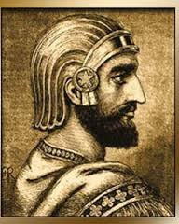
Decree of Cyrus
"This is what Cyrus king of Persia says: 'The LORD, the God of heaven, has given me all the kingdoms of the earth and he has appointed me to build a temple for him at Jerusalem in Judah. ³Any of his people among you may go up to Jerusalem in Judah and build the temple of the LORD, the God of Israel, the God who is in Jerusalem, and may their God be with them. ⁴And in any locality where survivors may now be living, the people are to provide them with silver and gold, with goods and livestock, and with freewill offerings for the temple of God in Jerusalem' " (Ezra 1:2-4 NLT).

Slide 26

The Persian Empire
Susa
The Persian Empire in the 5th century BC
extended "from India and Ethiopia" (Esther 1:1)
The boundaries of the empire that Cyrus II initiated
and Darius I consolidated stretched from Greece to India
Notes:
Cyrus ruled over an absolutely ENORMOUS kingdom that eventually stretched from Greece in the west and India in the east. From his capital at Susa he had control over 127 provinces! God moved his heart to initiate a return to the land not only for the Jews but for other conquered peoples—as long as they would pray for the welfare of the king and his sons.

Slide 27
But WHY was a return to the land of Israel so important?

Slide 28
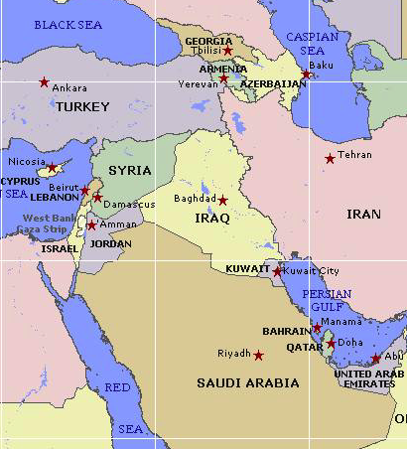

Borders of the Land Promised to Abraham
44
Genesis 15:18
On that day the LORD made a covenant with Abram, saying, "To your offspring I give this land, from the river of Egypt to the great river, the river Euphrates" (ESV)
Notes:
28

Slide 29
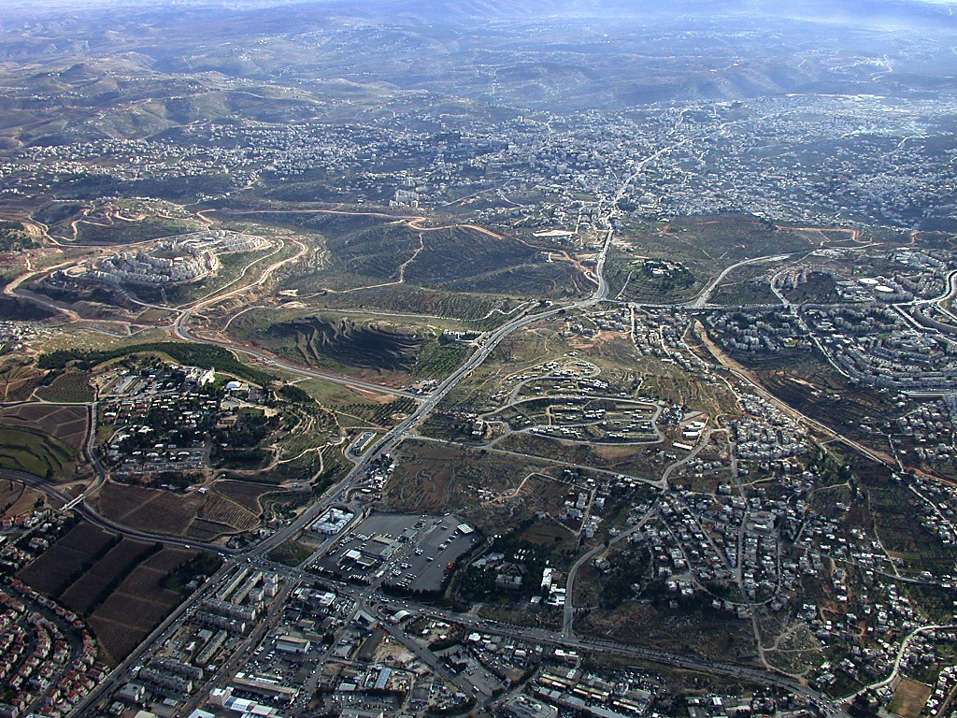
Bethlehem aerial from north
Herodium
Bethlehem
Church of Nativity
Rachel's Tomb
Har Homa
Tantur
Mar Elias
Ramat Rahel
Bethlehem aerial from north near Jerusalem
Notes:
29
Bethlehem in the Old Testament
Bethlehem was the home of Micah's Levite priest (Jud 17:1-13).
Ruth harvested in the fields of Boaz in Bethlehem.
Three generations after Ruth, David was born in Bethlehem (Ruth was David's great-grandmother).
David was anointed king in Bethlehem (1 Sam 16:1-13), but he chose not to make this city his capital.
Bethlehem was the home of Joab, Abishai, and Asahel. Asahel was buried here (2 Sam 2:32).
Bethlehem was also the home of Elhanan, one of David's mighty men (2 Sam 23:24; 1 Chr 11:26).
Rehoboam fortified Bethlehem (2 Chr 11:6).
Many Jews fled to Bethlehem after Gedaliah was killed (Jer 41:17).
The city was rebuilt after the return from Babylonian exile (Ezra 2:21; Neh 7:25).
Bethlehem was named as the place of the Messiah's birth (Micah 5:2; John 7:42).

Slide 30
Slides on
Ezra 2
Notes:
The list of returning exiles had 50,000 Jews who returned and gave freewill offerings for the temple reconstruction to show God fulfilling his promise of restoration (Ezra 2).

Slide 31

Chronology of the Captivity
Judah's Captivity 605-536
Temple's Desolation 586-516
70 years
50 years
70 years
620
610
600
590
580
570
560
5 5 0
5 4 0
530
520
510
500
490
Judgments = 70 years
Bondage = 50 years (586-536)

Slide 32
Chronology of the Captivity
Judah's Captivity 606-536
Temple's Desolation 586-516
Ezekiel 597-572
620
610
600
590
580
570
560
5 5 0
5 4 0
530
520
510
500
490
Daniel: 606-536

Slide 33
Chronology of Ezra-Nehemiah
Ezra (457-444)
Nehemiah (444-430)
Zerubbabel (537-516)
540
530
520
510
500
490
480
4
7
0
4
6
0
450
440
430
420
410
537
457
444
430
Haggai & Zechariah 520
Esther
479-473
Malachi 432

Slide 34
Ezra's Correlation with Esther
289
Restoring the Temple and People
Temple
Book of Esther (58 YEAR GAP)
People
Zerubbabel
Ezra
Ezra 1–6
Ezra 7–10
50,000 Return
5,000 Return
Survival
Revival
Working
Worshipping
538-516 BC (22 Years)
458-457 BC (1 Year)
External Opposition: Samaritans
Internal Opposition: Intermarriage
Return
1–2
Rebuilding
3–6
Return
7–8
Restoration
9–10
Decree
1
Returnees
2
Begins
3
Opposed
4:1–6:12
Ends
6:13-22
Qualifications
& Provisions
7
Returnees
& Protection
8
Inter- marriage
& Lament
9
Divorces
Carried Out
10

Slide 35
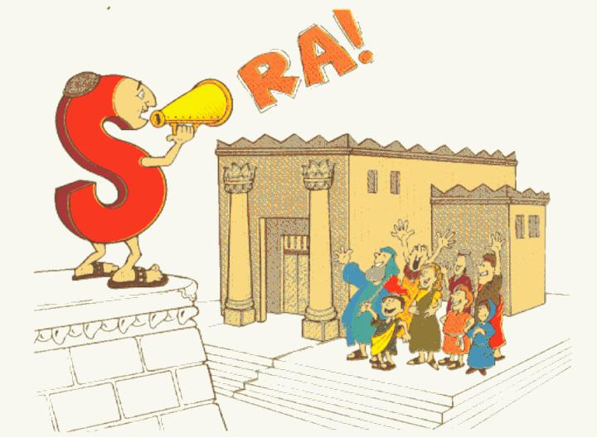
Temple/People
Ezra:
Walk Through The Bible ©1989

Slide 36
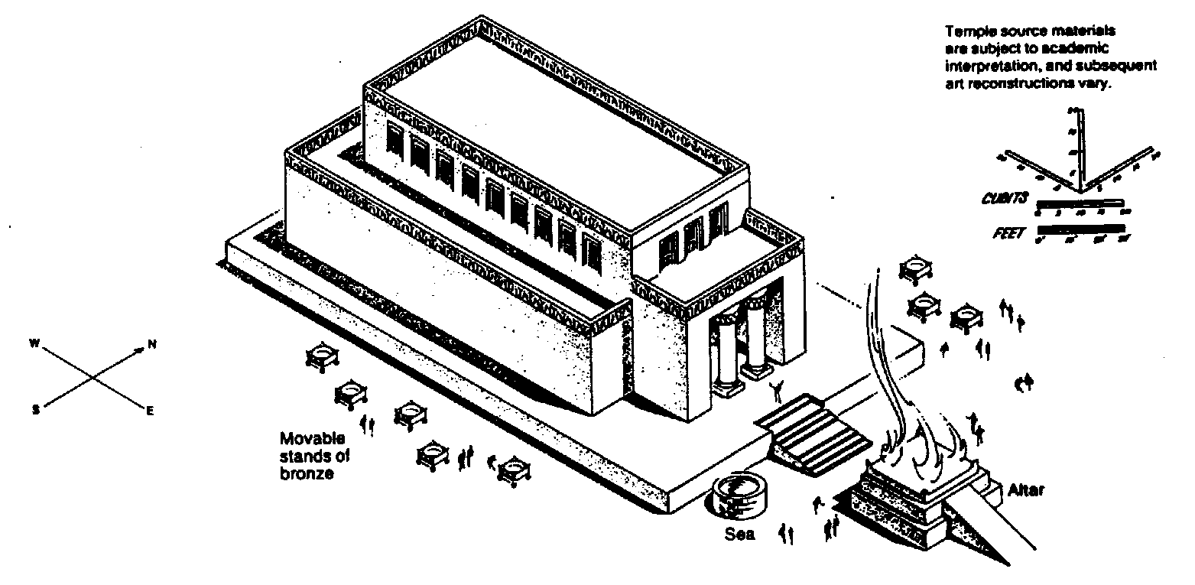
Zerubbabel's Temple
The Bible Visual Resource Book, 95
298
Key Word
Temple
Key Verse
"… for a brief moment, the LORD our God has been gracious in leaving us a remnant and giving us a firm place in his sanctuary, and so our God gives light to our eyes and a little relief in our bondage" (Ezra 9:8)

Slide 37
Characteristics
290-291
C. The restoration to the land under Ezra & Nehemiah related directly to God's purposes for Israel as stated in the promise to Abraham (Gen. 12:1-3).
2. Relationship to the Abrahamic Covenant
God promised Abraham that his descendants would occupy the land from the River of Egypt to the Euphrates (Gen. 15:18), yet Israel in Babylon was living outside of these boundaries. The nation needed to return to the land.
The Messiah had already been prophesied to be born in Bethlehem (Micah 5:2).
c) Intermarriage threatened the purity of the Davidic line to fulfill the seed promises originally given to Abraham.

Slide 38
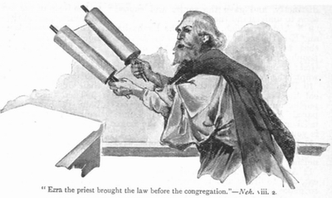
Synthesis
292
Restoring the temple and people
Partial fulfillment of land promise
1–6 Temple–Zerubbabel
7–10 People–Ezra

Slide 39
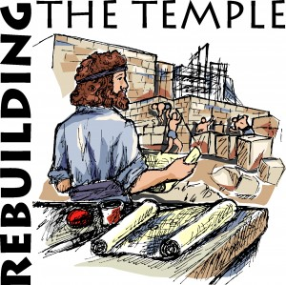
Ezra 1–6
EZRA
NEHEMIAH
  Restoring 3–6
  Returning 1–2
Rebuilding
1–6
Zerubbabel
537

Slide 40
Slides on
Ezra 3
Notes:
God restored temple worship despite opposition and the idolatry that caused the exile (Ezra 3–6).
Temple rebuilding began by rebuilding the altar and foundation and resuming sacrifices as God's help to worship at the temple—not the high places (Ezra 3).

Slide 41
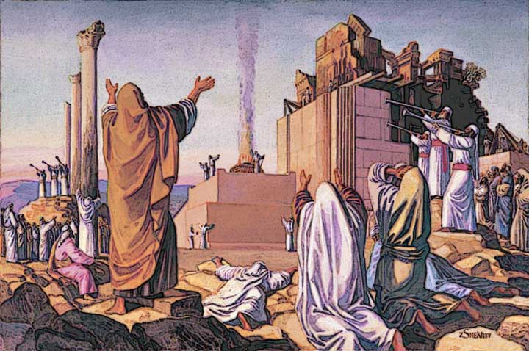
The altar was rebuilt first (Ezra 3:1-6)

Slide 42
Slides on
Ezra 4
Notes:
Enemies halted the temple rebuilding for 16 years until Zechariah and Haggai exhorted the Jews to continue until God moved the key enemy to assure their success (4:1–6:12).

Slide 43
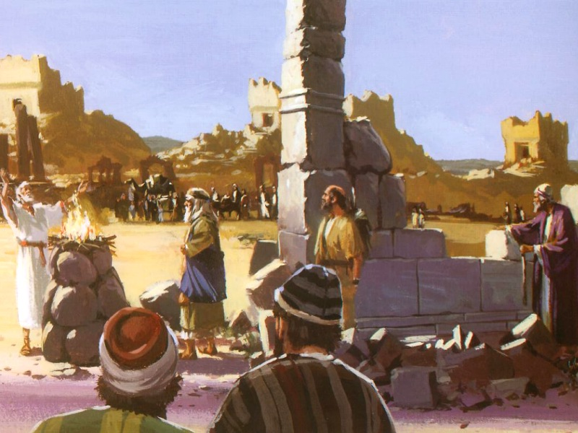
God's work was opposed (4:1-2)

Slide 44
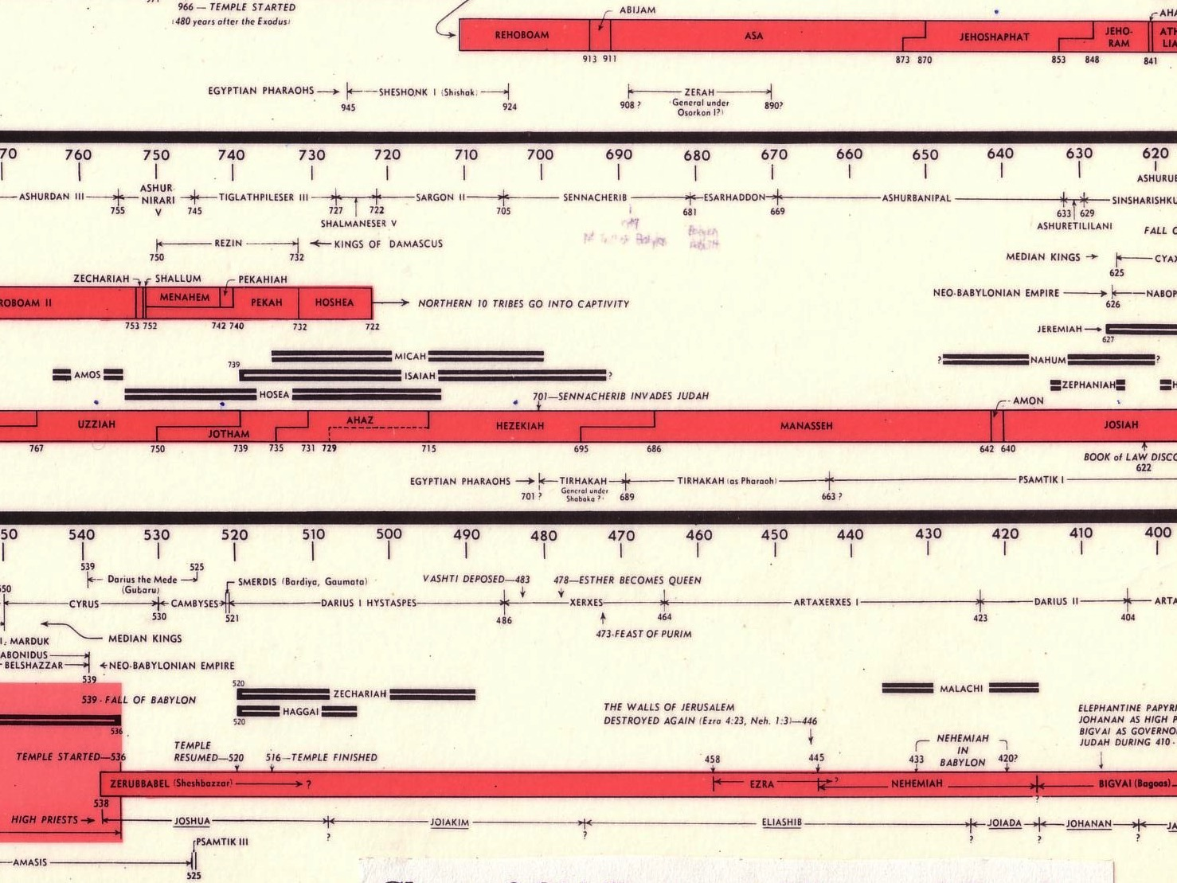
Opposition Timeline (Ezra 4)
232 & 342
Under Cyrus
536-520 BC
Under Xerxes
486 BC
Under Artaxerxes
±460 BC
Chart of Old Testament Kings and Prophets
John C. Whitcomb, 4th rev. ed., Winona Lake, IN: BMH Books, 1962, 1968, p. 2

Slide 45
Slides on
Ezra 5

Slide 46
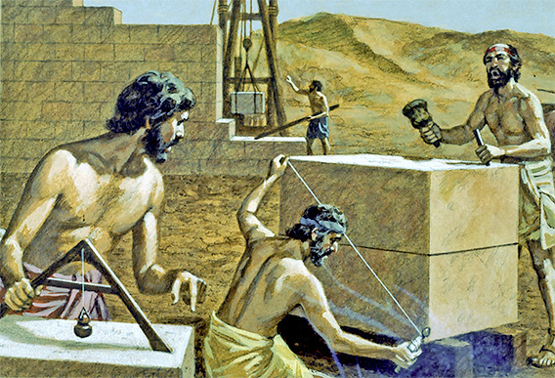
God's work is always opposed

Slide 47
Ezra's Correlation with Esther
289
Restoring the Temple and People
Temple
Book of Esther (58 YEAR GAP)
People
Zerubbabel
Ezra
Ezra 1–6
Ezra 7–10
50,000 Return
5,000 Return
Survival
Revival
Working
Worshipping
538-516 BC (22 Years)
458-457 BC (1 Year)
External Opposition: Samaritans
Internal Opposition: Intermarriage
Return
1–2
Rebuilding
3–6
Return
7–8
Restoration
9–10
Decree
1
Returnees
2
Begins
3
Opposed
4:1–6:12
Ends
6:13-22
Qualifications
& Provisions
7
Returnees
& Protection
8
Inter- marriage
& Lament
9
Divorces
Carried Out
10

Slide 48
Slides on
Ezra 6
Notes:
The Jews celebrated the completed temple rebuilding in 516 BC (20 years after its beginning) with a special dedication and Passover observance (6:13-22).

Slide 49
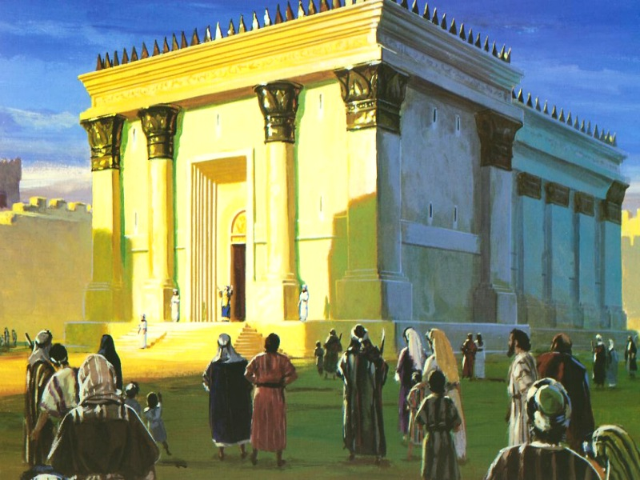
Temple Completion in 516 BC (Ezra 6:15)

Slide 50
Outline
292-294
I. Ezra 1–6: The rebuilding of the temple in the first return under Zerubbabel with 50,000 Jews encourages the remnant to worship only at the temple because of God's faithfulness in fulfilling His promise of restoration (538 BC).

Slide 51
Slides on
Ezra 7
Notes:
The second return under Ezra the priest with 5,000 Jews shows that God mercifully protects all who trust him (Ezra 7–8).

Slide 52


Which is more important?
Hardware?
Software?
Notes:
We all know that hardware without software just sits there useless.
Likewise, software without a computer to run it does no good.

Slide 53
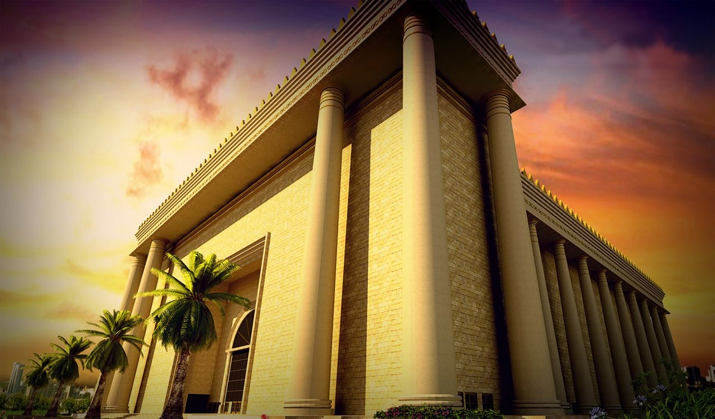
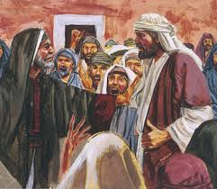
Which is more important?
Hardware?
Software?
Rebuild Temple
Rebuild People
Notes:
In the same way, Israel needed more than simply having a temple in their midst.
They needed hearts tuned to God.

Slide 54
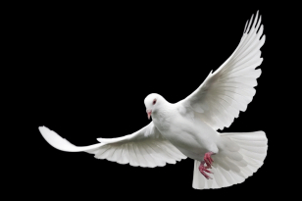
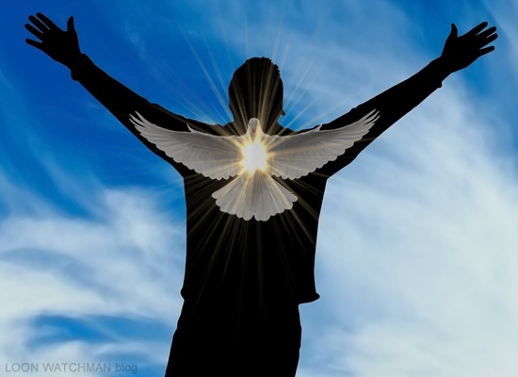
Which is more important?
Presence of the Spirit?
Submission to the Spirit?
Notes:
The presence of God came to Israel in the temple—and the Spirit comes into us as Christians (1 Cor 6:19)
But what good is it for us to have God's indwelling Spirit and then ignore him?

Slide 55
Outline
292-294
I. Ezra 1–6: The rebuilding of the temple in the first return under Zerubbabel with 50,000 Jews encourages the remnant to worship only at the temple because of God's faithfulness in fulfilling His promise of restoration (538 BC).
II. Ezra 7–10: The reformation of the people in the second return under Ezra with 5,000 Jews is recorded to encourage the remnant to fulfill its covenant obligations on the basis of God's mercy (458 BC).

Slide 56
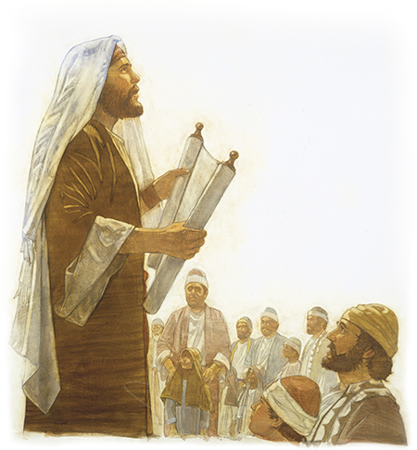
"For Ezra had devoted himself to the study and observance of the Law of the LORD, and to teaching its decrees and laws in Israel"
(Ezra 7:10 NIV).
Notes:
Ezra's credentials to lead more returnees back to Jerusalem show God leading his life as priest to restore the remnant spiritually (7:1-10).
Ezra was a priest (7:1-5).
Ezra was a teacher (7:6a).
Ezra saw the hand of God on his life (7:6b-9).
Ezra prioritized the study, obedience, and teaching of the law (7:10).
God funded the return by King Artaxerxes giving money and authority to Ezra to lead and tax exemption for temple workers to show how God blesses obedience (7:11-28).

Slide 57
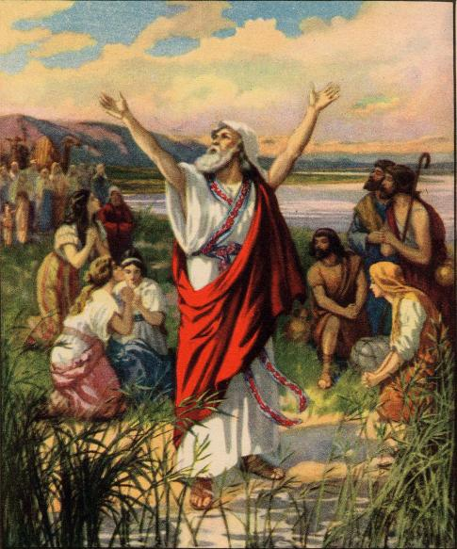
Ezra 7–10
EZRA
NEHEMIAH
EZRA
  Restoring 3–6
  Returning 1–2
  Returning 7–8
  Restoring 9–10
Rebuilding
1–6
Redirecting
7–10
Zerubbabel
Ezra
537
457

Slide 58
Slides on
Ezra 8
Notes:
Returnees of 18 family heads, 1496 other men, women and children, totaled about 5,000—a far smaller group than the 50,000 with Zerubbabel 80 years before (8:1-14).

Slide 59
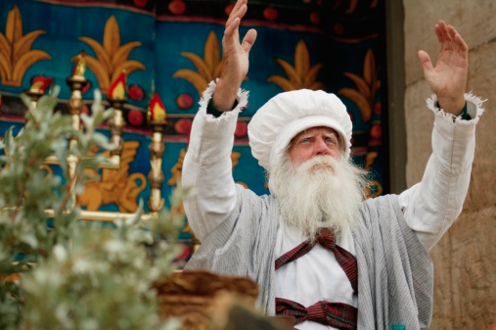
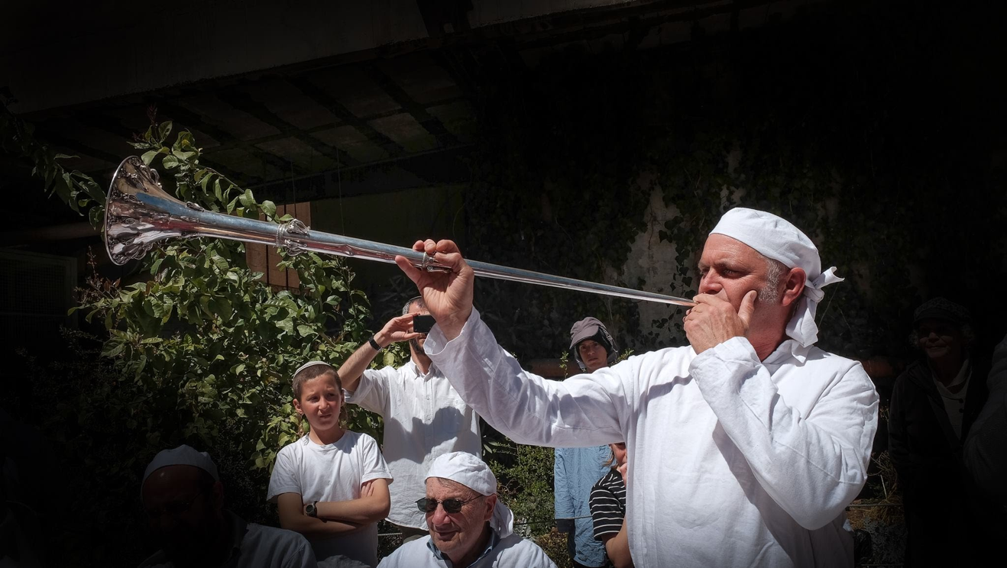
Leadership for Revival (Ezra 8:15-20)

Slide 60
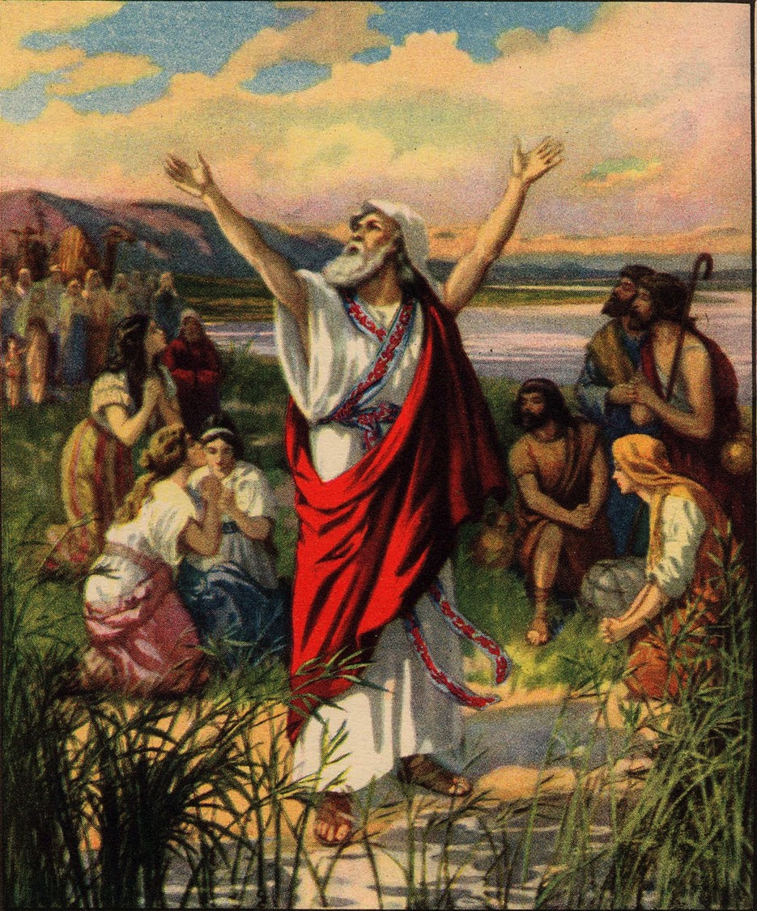
Ezra proclaims a fast
(Ezra 8:21)
Notes:
God protected the returnees due to their spiritual preparation by adding 258 Levites as temple leaders and celebrating a fast to show his hand on all who trust him (8:15-36).

Slide 61
Slides on
Ezra 9
Notes:
God protected the messianic seed through Ezra's restoration of the people by separating from foreign wives (Ezra 9–10).
Ezra saw that leaders tempted Judah to sin by unlawful marriage to pagan wives (9:1-2; cf. Gen 24:3; 26:34-35; 28:1-8; Exod 34:16; Deut 7:1-2; 20:17-18; Judg 3:5; 1 Kings 11).

Slide 62
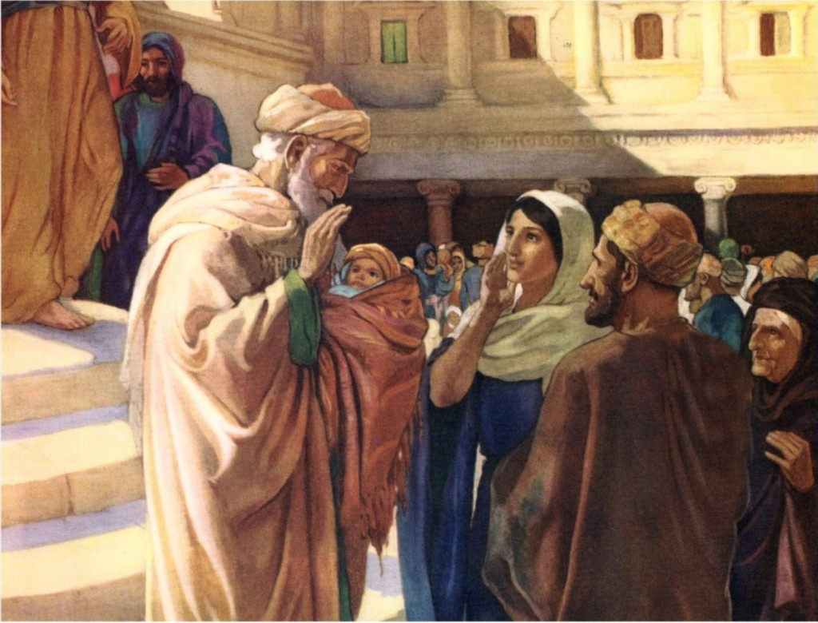
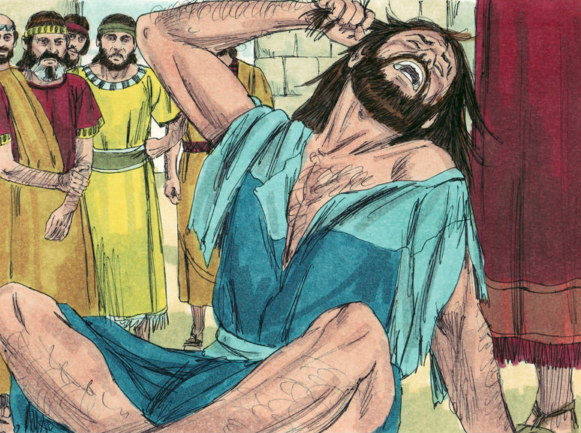
Internal Opposition (Ezra 9)
Notes:
Ezra lamented the intermarriage and contrasted God’s faithfulness with Israel's unfaithfulness to model repentance for the covenant people (9:3-15).

Slide 63
Slides on
Ezra 10
Notes:
The initiation by the leaders that Israelites divorce their foreign wives was carried out faithfully for 113 men to exhort Israel to live according to the covenant (Ezra 10).

Slide 64
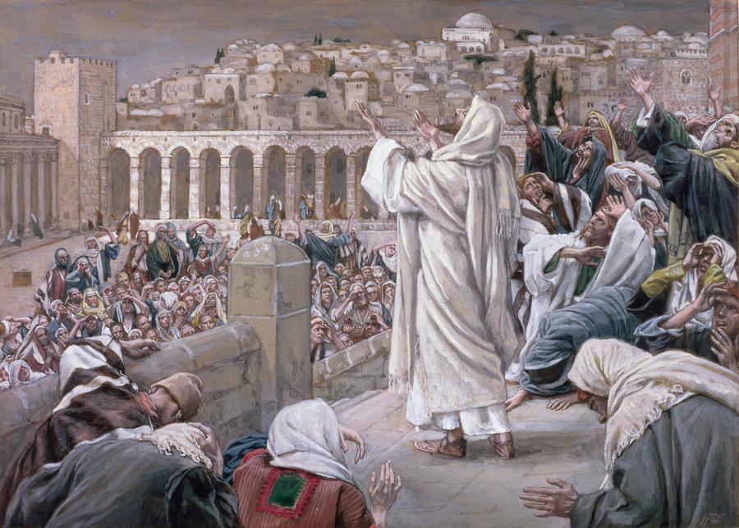
Public Confession of Sin (Ezra 10)
Notes:
After the whole nation lamented the sin of intermarriage, the leaders initiating the idea to divorce all foreign wives fulfilled their vow to do so (10:1-17).
That those who divorced pagan wives included priests, Levites, and commoners shows the great extent that this sin corrupted the holy nation (10:18-44).

Slide 65
God Approved Divorce under Ezra?
294
Issue: How could God approve of divorce here when He elsewhere disapproves of it and even says clearly, "I hate divorce" (Mal. 2:16; cf. Matt. 19:8)?
The text doesn't specifically say that God approved of divorce. One solution could have been for the 113 men to leave the community with their families. However, for the sake of argument, the other reasons below are offered…
The account serves to illustrate that maintaining the purity of the covenant people of God was more important than even keeping some individual families intact.
Although 113 men may seem to be a small number, since this included leaders of the people, the intermarriage was certainly going to spread further to all the common people as had happened in the Jewish community in Egypt & the kingdom of Israel to the north.

Slide 66
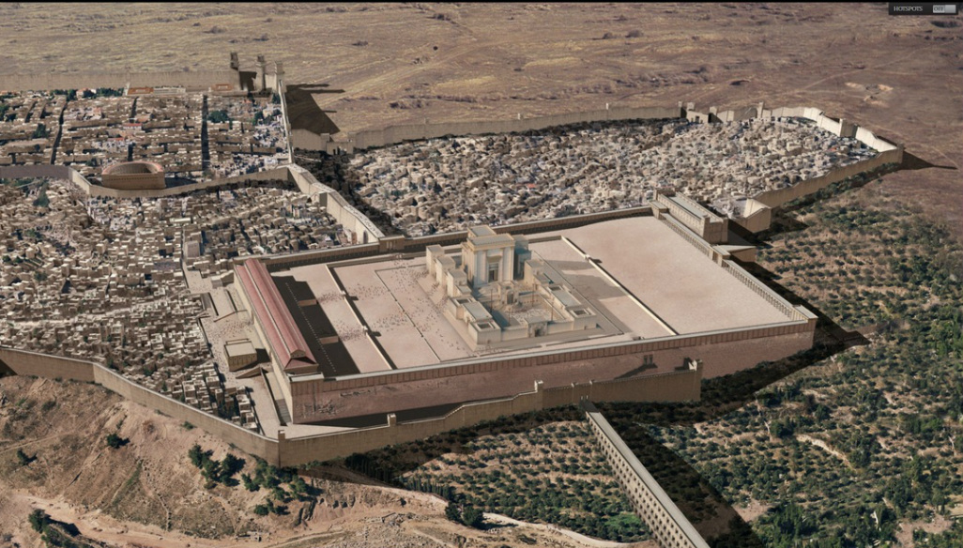
This small beginning led to the first century AD restoration of Jerusalem

Slide 67
Why does God restore us?
Notes:
Why are we essentially delivered from our old way of life?
God routinely delivers us even though we are at fault for neglecting him. So why does he rescue or deliver us?

Slide 68
II. God delivers us from our bondage to worship him.
Ezra for Us
Notes:
The LORD has brought you from your slavery to sin into the freedom to adore him!

Slide 69


God knows how horrible slavery to false gods is for us.
Breaking free
Notes:
God knows how horrible slavery to false gods is for us.
Israelites even killed their own children in false worship of Molech.
Sadly, we do the same today.

Slide 70
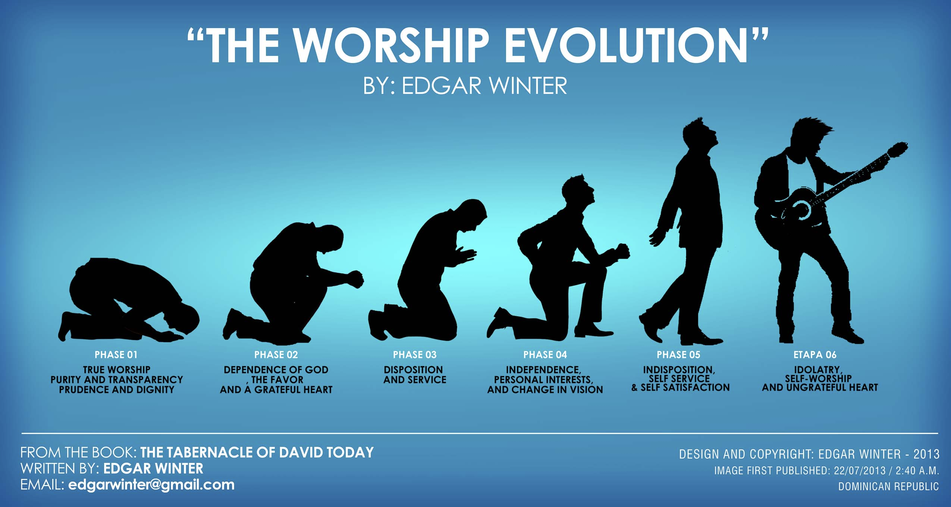
Do you need to be restored from your slavery to sin?
“THE WORSHIP EVOLUTION”
ADAPTED FROM EDGAR WINTER
PHASE 1
True Worship,
Purity & Transparency,
Prudence & Dignity
PHASE 2
Dependence on God
& His Favor
with a Grateful Heart
PHASE 3
Disposition
& Service
PHASE 4
Independence,
Personal Interests,
& Change in Vision
PHASE 5
Indisposition,
Self-Service &
Self-Satisfaction
PHASE 6
Idolatry,
Self-Worship &
Ungrateful Heart
Notes:
That slavery is too often an idolatry when we become the focus of worship (explain devolution above)
Do you have habits that you just can’t seem to ever conquer?
Many men over the years have confessed their bondage to porn.
Women, likewise, can be enslaved to movies—or shopping—or other forms of slavery, such as romanticizing their lives.
Why does God want to restore you?

Slide 71
Why does God restore us?
Notes:
Why are we essentially delivered from our old way of life?
God routinely delivers us even though we are at fault for neglecting him. So why does he rescue or deliver us?

Slide 72
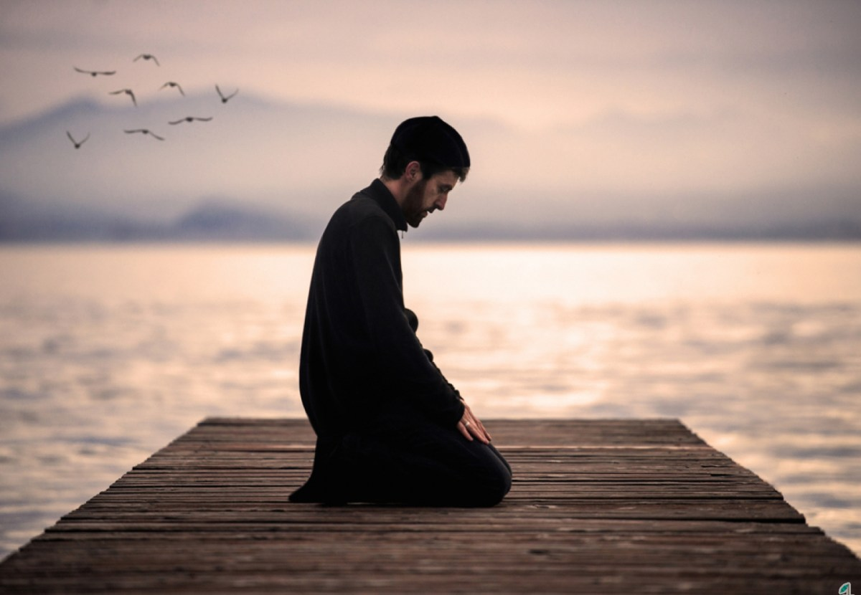
Main Idea of Ezra
God transforms
EXILES
WORSHIPPERS
INTO
Notes:
The LORD is in the business of taking people in bondage and making them into people who honor him

Slide 73
I. God delivered the Jewish exiles to worship him.
The Book of Ezra
Notes:
He brought the Jews from being kicked out of their land back to that land so they would honor him.

Slide 74
Summary Statement
289
The restorations of the temple and people to the land under Zerubbabel and Ezra record God's faithfulness and mercy in fulfilling His promise of restoration to encourage the remnant in true temple worship and covenant obedience.

Slide 75
II. God delivers us from our bondage to worship him.
Ezra for Us
Notes:
The LORD has brought you from your slavery to sin into the freedom to adore him!

Slide 76

My Journey in Worship
Notes:
I must confess that my own journey in worship was just that—a journey with its highs and lows, pitfalls and heights. I learned in college that worship is really the most important element in life, but I really struggled to get out of bed in the morning to worship God. So I shared this with my close friend Albert. He asked, "So what time do you need to get out of bed to read your Bible and pray?" I said, "Well, to leave for class at 6:45 AM but have a decent breakfast and shower before that, I need to get up at 5:30 AM to read and pray for 30 minutes."
"OK," Albert told me, "I will call you at 5:30 tomorrow morning."
Do you think I had trouble getting out of bed the next day? Not on your life! I especially knew that my parents would hear the phone and wake up, so I made sure I was at my desk and picked up the line before it could even have a full ring.
"Hey, Rick, good morning!" Albert said, "Are you at your desk meeting with God?"
"Yes," I said. "Good! Talk to you tomorrow!"
The phone call was probably the shortest call I've ever had—but also the most impactful call I've ever had.
Sure enough, Albert called the next day, and the next day, and the next day. After three weeks, I had a new habit and I told him I didn't need the calls anymore.
I went on to get my PhD in that Book, and Albert went on to lead the regional Young Life ministry.
What's the point? Worship isn't easy and doesn't come at naturally for most of us. We need help.
I have built-in help now, as Susan and I commit to pray and read God's Word together each day. Honestly, I need that kind of accountability. I suspect you do too!

Slide 77
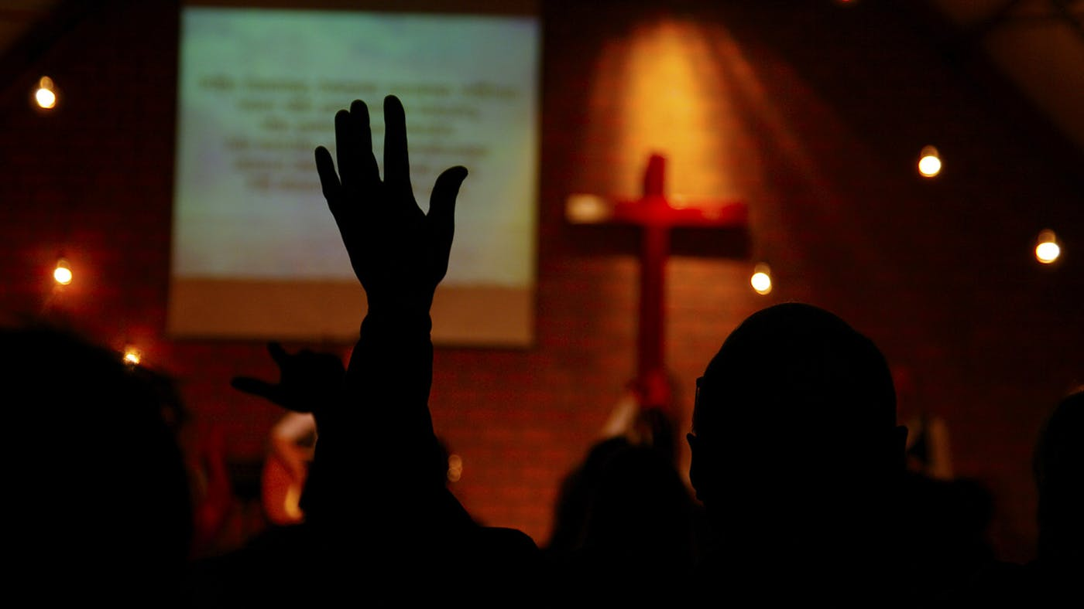
What would change in your life if your chief reason to live were to worship?
Notes:
How would your priorities change?
What would you have to give up to give God first place in your morning?
One friend taught me a great principle. He found that he always made time for breakfast, so he established a new personal rule: No Bible, no breakfast.
Maybe what would change for you is your independence. You, like me, just have to acknowledge your weakness to worship God and you need help from a friend.
As you are dependent on God, so you may need to be dependent on someone else—your own Albert—to help you be dependent on God!
Would you come early for prayer and preparation?
Would reading God’s Word daily be a delight instead of a chore?
Would you begin to lead others in worship?
Would you see your body as the new temple of the Spirit so you would take care of his temple better?

Slide 78
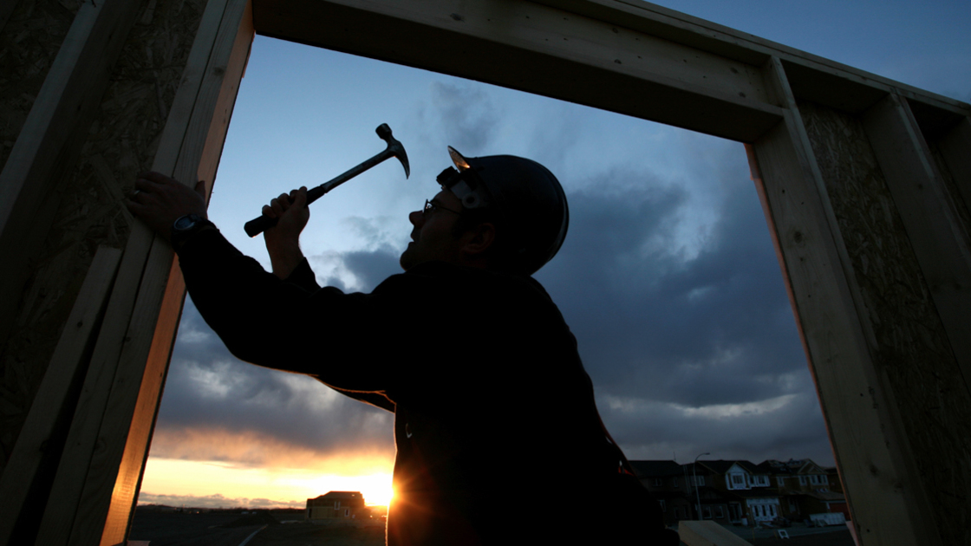
Application
289
Restoration to God for the repentant believer requires action.
Notes:
To do some rebuilding in the priority of worship, what kind of action is God calling you to take?

Slide 79
Black

Slide 80


Bible Exposition link at BibleStudyDownloads.org
Get this presentation and script for free!

